Slide 1
Scaling Learning to Rank to Big data
A study concerning the parallelisation of learning to rank algorithms using the mapreduce computing model

Slide 2
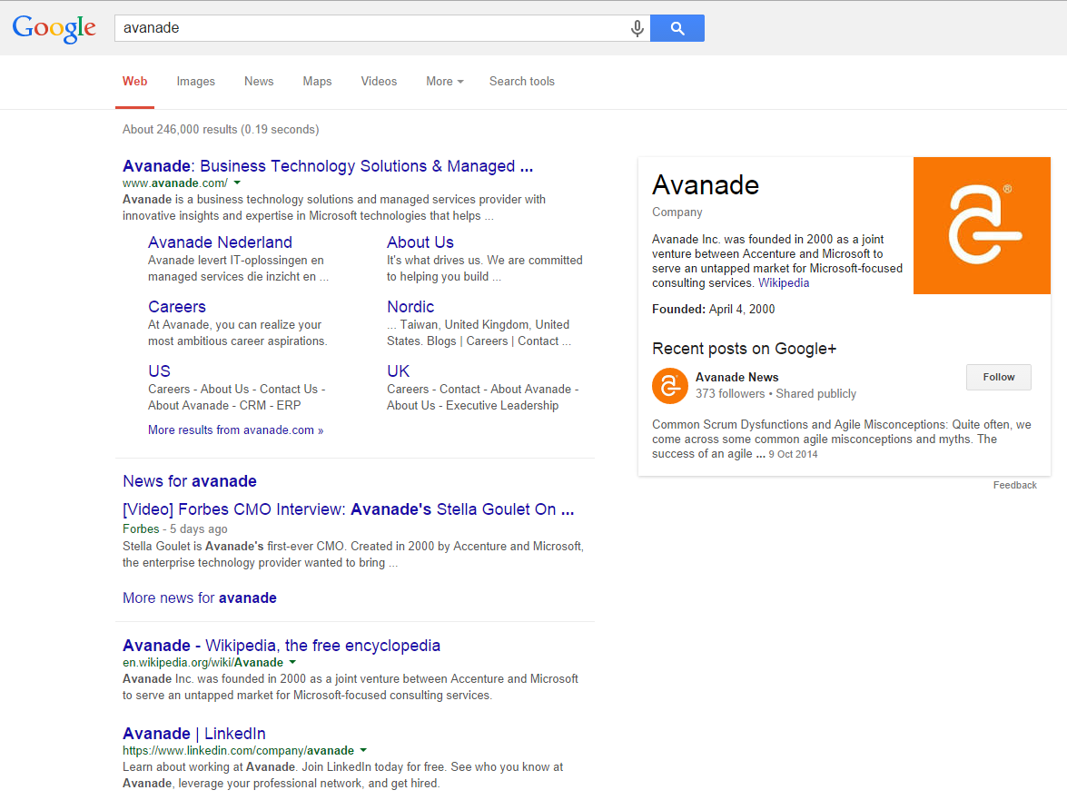

Slide 3
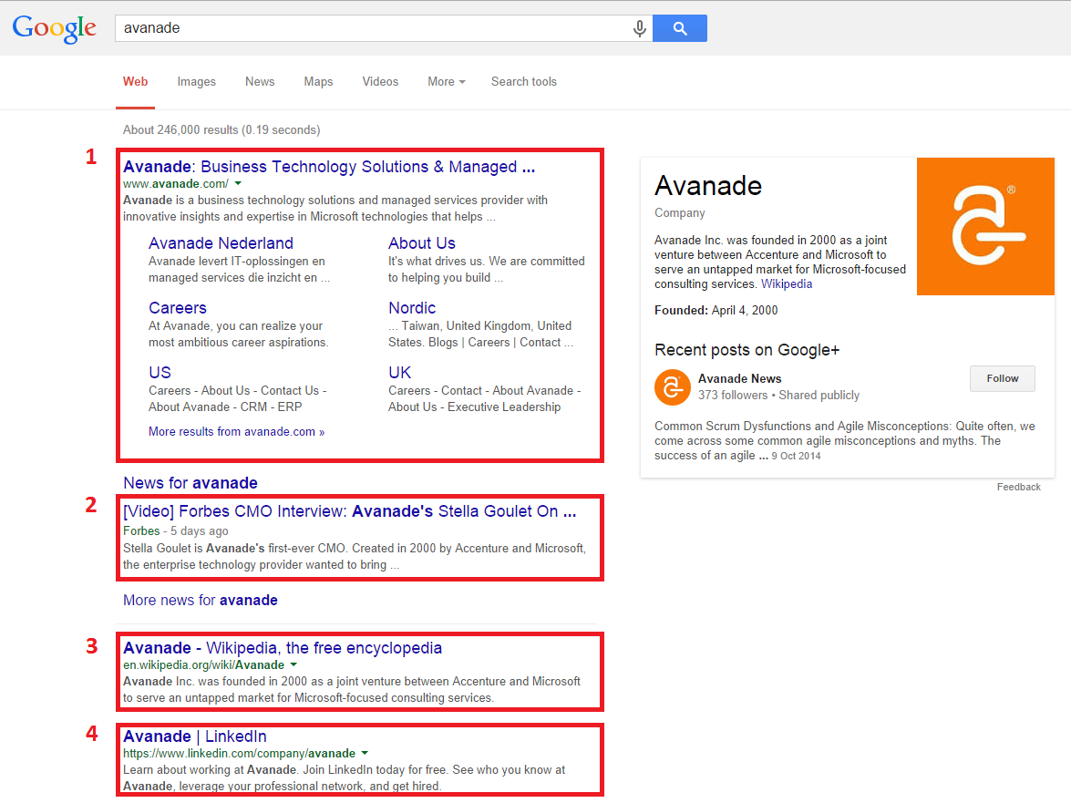

Slide 4
AVANADE Touch Analytics
HIER KOMEN TWEE SLIDES OVER AVANADE TOUCH ANALYTICS

Slide 6
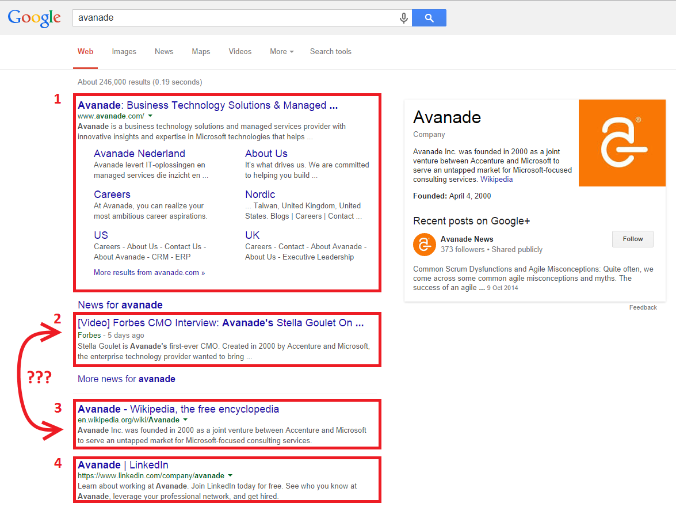

Slide 7



So… what makes a good ranking?
Normalized Discounted Cumulative Gain
Highly relevant documents are more useful when appearing higher in a search engine result list
Highly relevant documents are more useful than marginally relevant documents

Slide 8
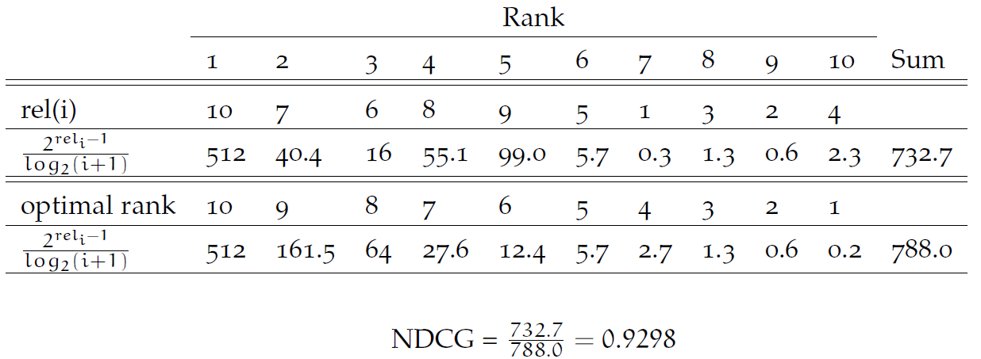
NDCG, an example calculation

Slide 9
There is more to ranking than being accurate
Scalability

Slide 10
Research Scope
We focus on exploring the scalability of the “most accurate” ranking methods.
But which are those “most accurate” ranking methods?

Slide 11


Many Benchmark datasets
LETOR 2.0
LETOR 3.0
LETOR 4.0
MSLR-web10/30k
Yahoo! Learning to Rank Challenge
Yandex Internet Mathematics Competition 2009
WCL2R
AOL

Slide 12
Search methodology
Forward reference search
Google scholar search

Slide 13
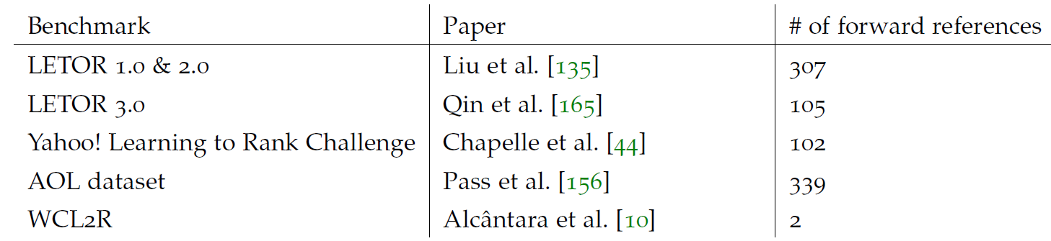
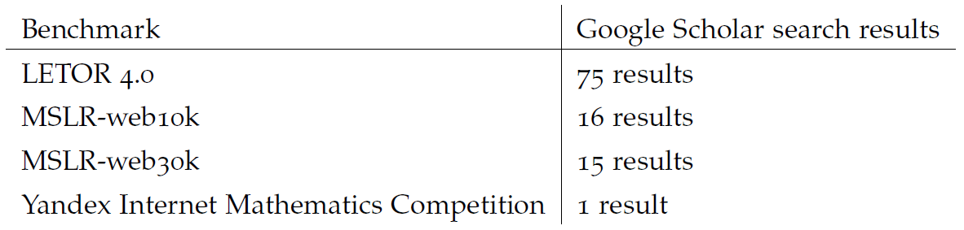
Search results

Slide 14
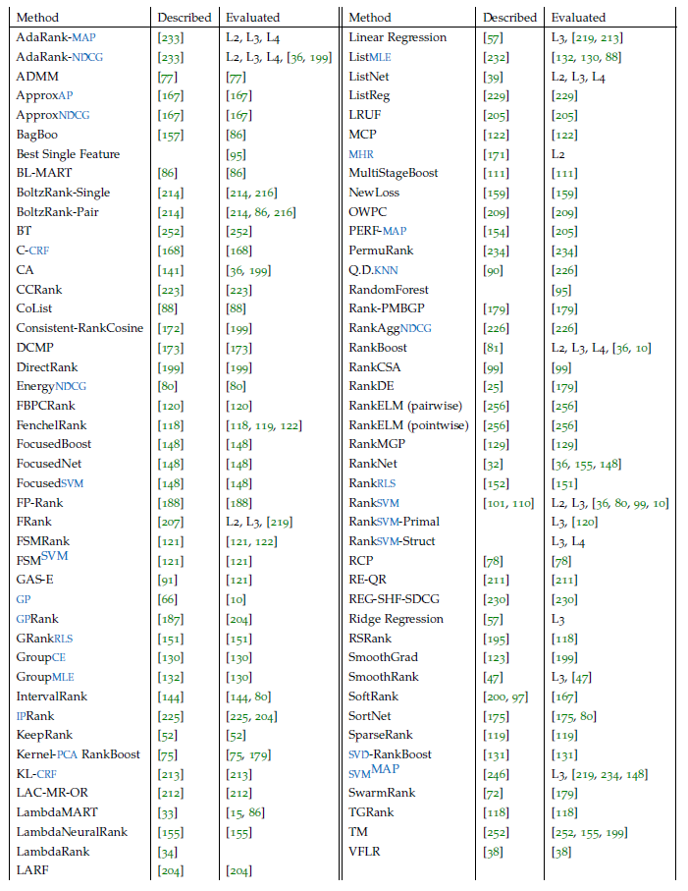

Slide 15
Winning Number
TODO: Uitleg Winning Number, Ideal Winning Number, Normalized Winning Number

Slide 16
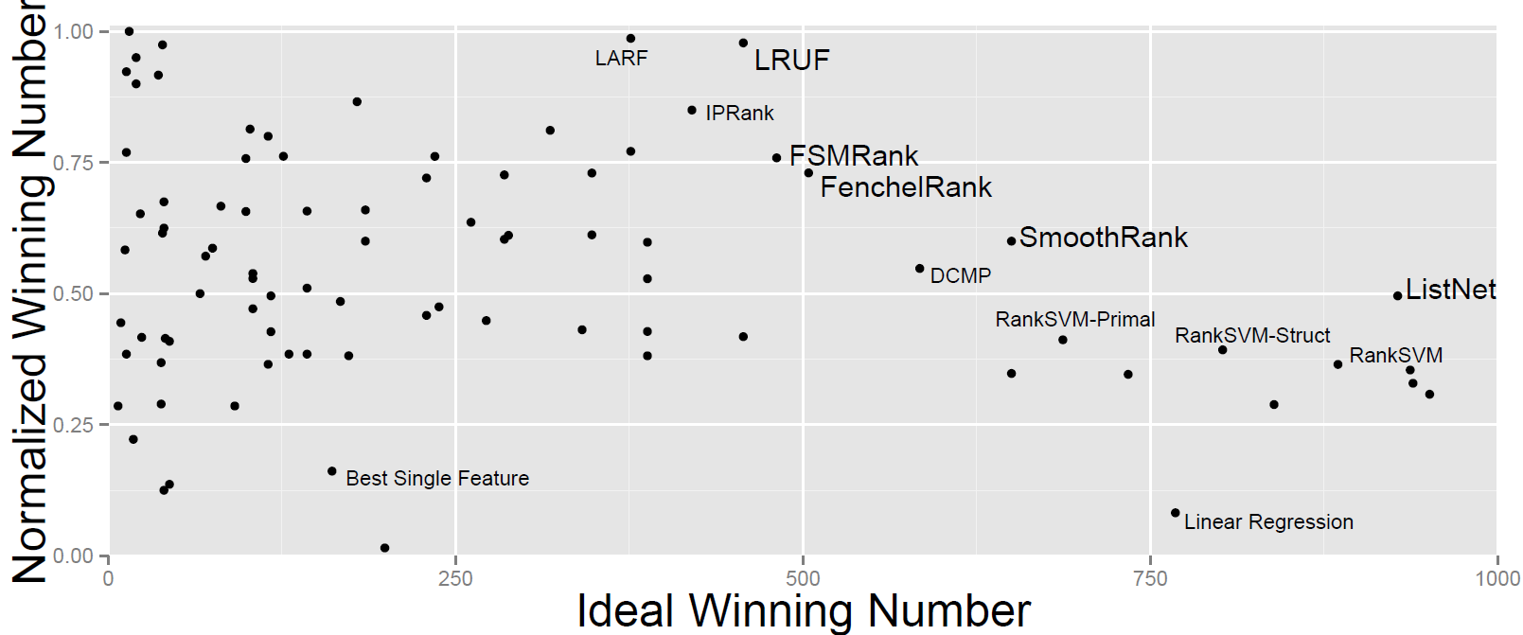

Slide 17
ListNet
TODO: ListNet uitleggen

